Slide 1
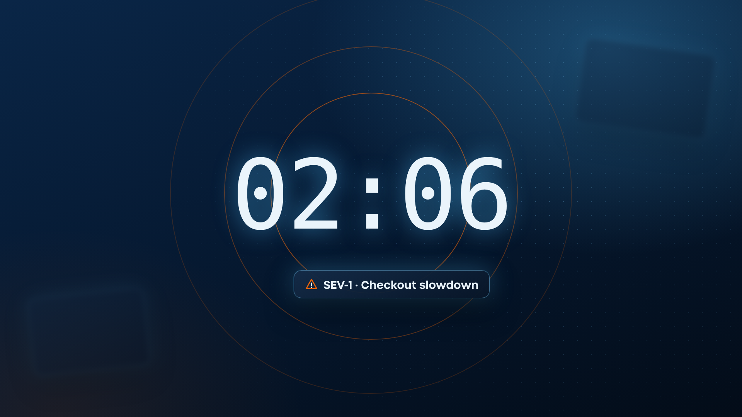
Frame 1
Visual:
Extreme close-up: the clock flips 02:05 → 02:06; an orange alert ripple pulses out and the SEV-1 chip slides in. Whip-pull back to the console (next frame).
Voiceover:
If you're a developer, I've got a question for you…
Super:
02:06 · Approve rollback?

Slide 2
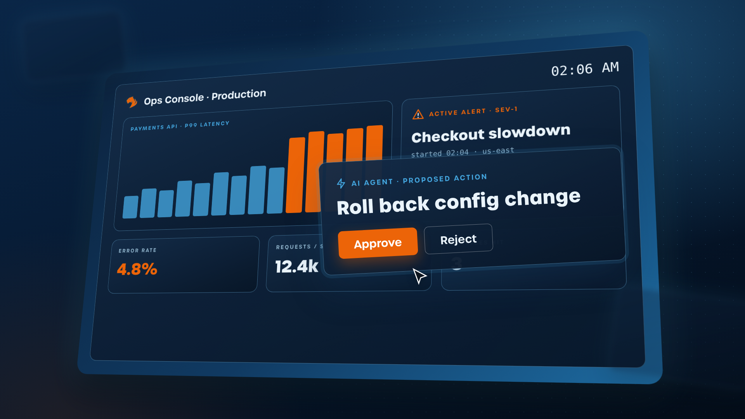
Frame 2
Visual:
Ops console in TigerGraph's product style (glowing UI cards on a deep-navy stage), 2:06 a.m. Latency spikes orange. The agent's plan pops up in an approval box: "Roll back config change." Cursor hovers over Approve. Animation: Open on an extreme close-up of the clock flipping 02:05 → 02:06, whip-pull back to reveal the tilted console swinging into place; latency bars shoot up and turn orange; the approval card springs forward out of the screen toward camera (overshoot + soft shadow); cursor glides in and hovers, Approve button breathes.
Voiceover:
It's 2 a.m and your AI agent wants to roll back a change in production. Do you click approve?
Super:
02:06 · Approve rollback?

Slide 3
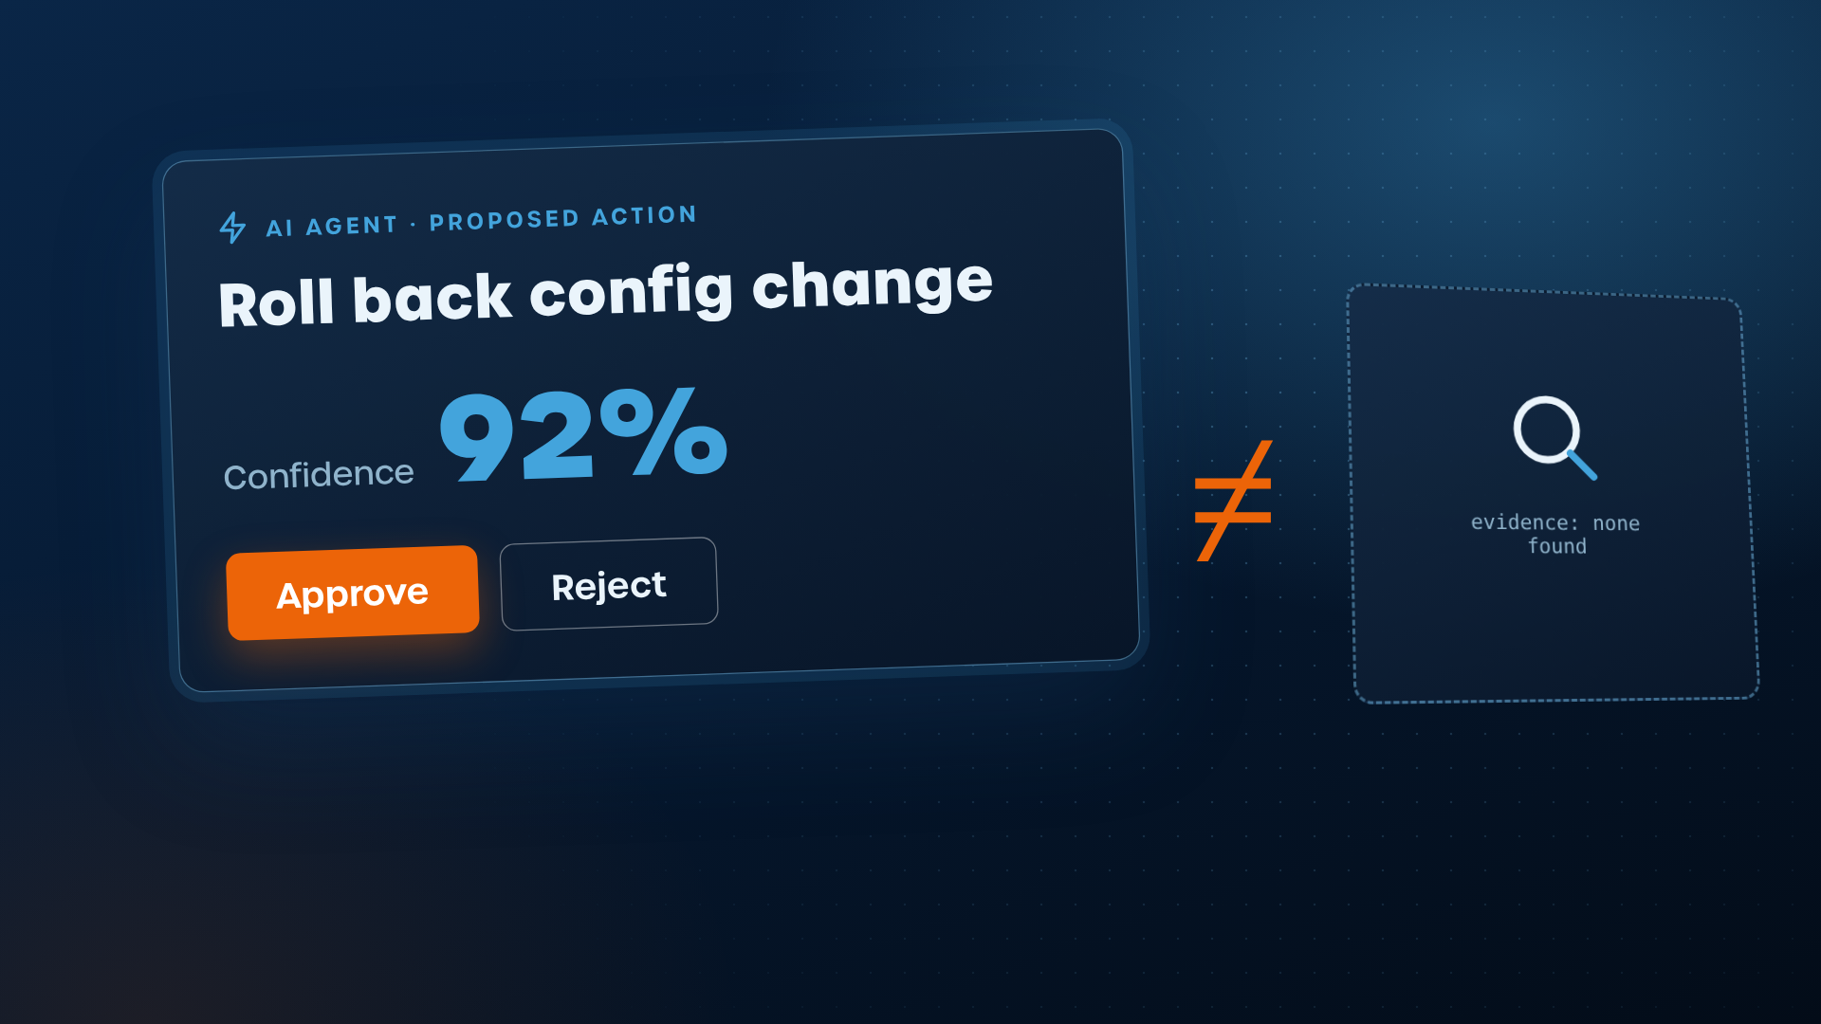
Frame 3
Visual:
Close-up: the approval box shows only an answer and "Confidence: 92%". The 92% is hollow: nothing behind it. Animation: Camera crashes into the card; 92% counts up 0 → 92 with a ticking SFX; on "isn't evidence" a magnifier sweeps over the number and finds nothing (empty dashed box), the % cracks and drops out of frame.
Voiceover:
Most agents give you an answer and a "confidence score". But confidence isn't evidence. You can't audit a percentage.
Super:
Confidence ≠ evidence

Slide 4
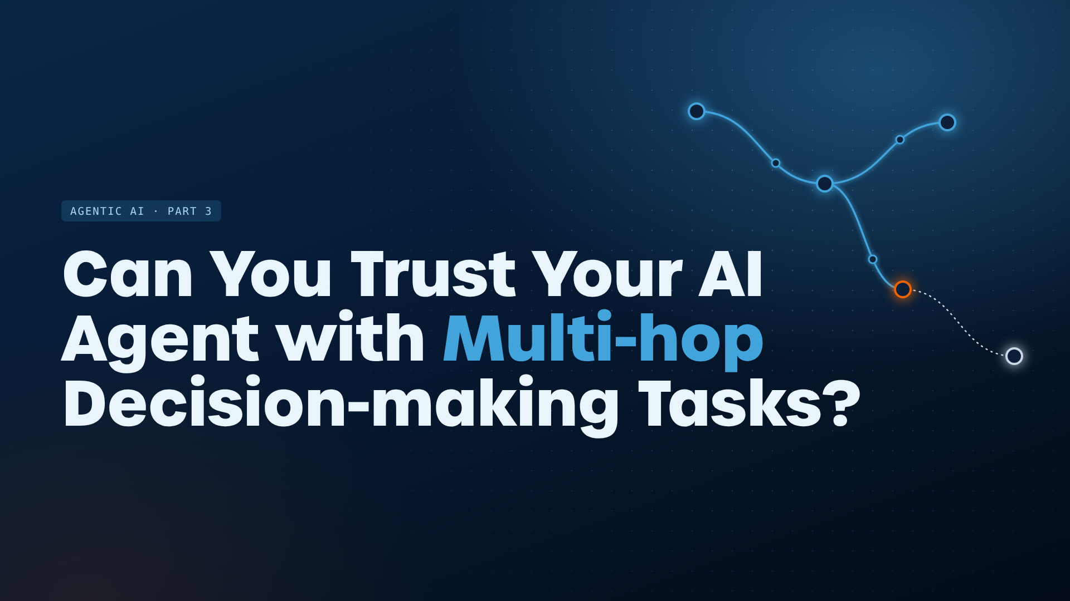
Frame 4
Visual:
Title card on deep navy with the brand node texture; 'Multi-hop' in TG Blue. Animation: Nodes fly in from depth and lock into a network behind the text; the title builds word by word with a slight 3D rotate-in; "Multi-hop" lights TG Blue as a light pulse hops across three nodes.
Voiceover:
(music sting, no VO)
Super:
Can You Trust Your AI Agent with Multi-hop Decision-making Tasks?

Slide 5
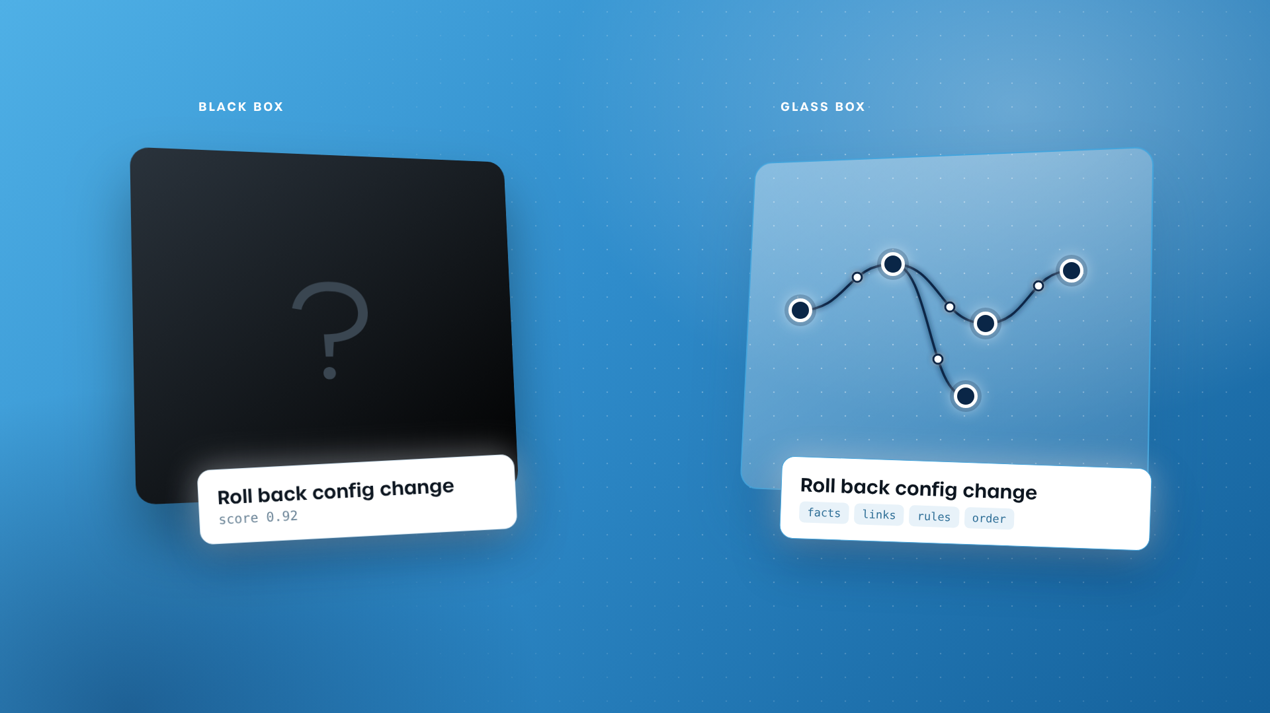
Frame 5
Visual:
Two cubes face off in 3D on TG Blue. Left: a solid black box that only outputs an answer and a score. Right: a clear glass box with the same answer plus a visible path of navy linked facts inside. Animation: Both cubes drop in and slowly rotate; the black box stays opaque and spits out a score tag; the glass box turns transparent and the path inside lights node by node on "facts… connect… rules… order", each with a soft click SFX. Camera orbits slightly between them.
Voiceover:
So what does it take for an agent to show its evidence? A black box gives you an answer, but a glass box gives you the answer AND the path behind it: which facts it used, how they connect, which rules it checked, and in what order.
Super:
Black box: answer + score · Glass box: answer + path

Slide 6
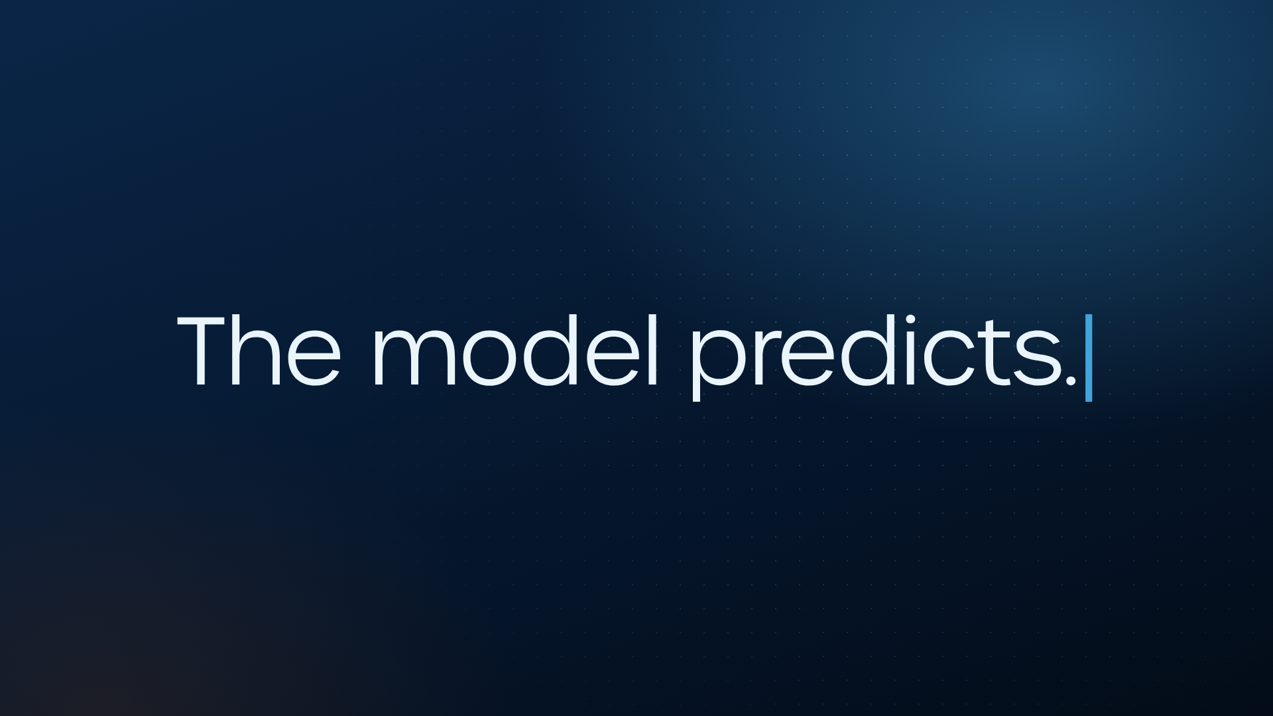
Frame 6
Visual:
"The model predicts." types on alone, centred, then lifts and blurs as the camera racks down to line 2.
Voiceover:
The model predicts.
Super:
The model predicts. The graph proves.

Slide 7
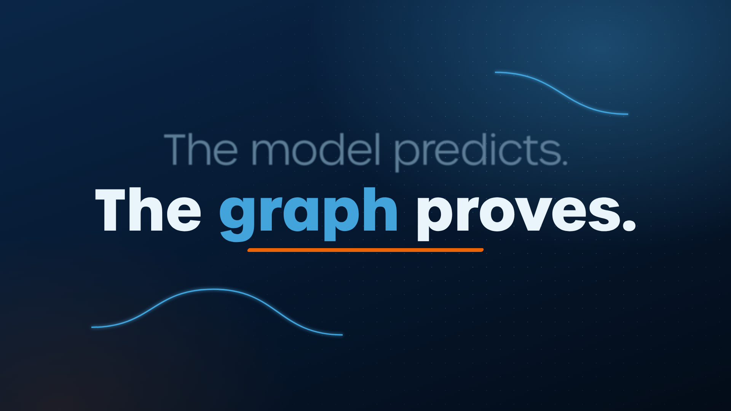
Frame 7
Visual:
Kinetic typography: the line resolves on screen. Animation: "The model predicts." types on in grey, slightly out of focus; camera racks focus down to "The graph proves." whose letters assemble from flying graph nodes; an orange underline whips across; a brief light flare passes over "graph".
Voiceover:
And the graph proves.
Super:
The model predicts. The graph proves.

Slide 8
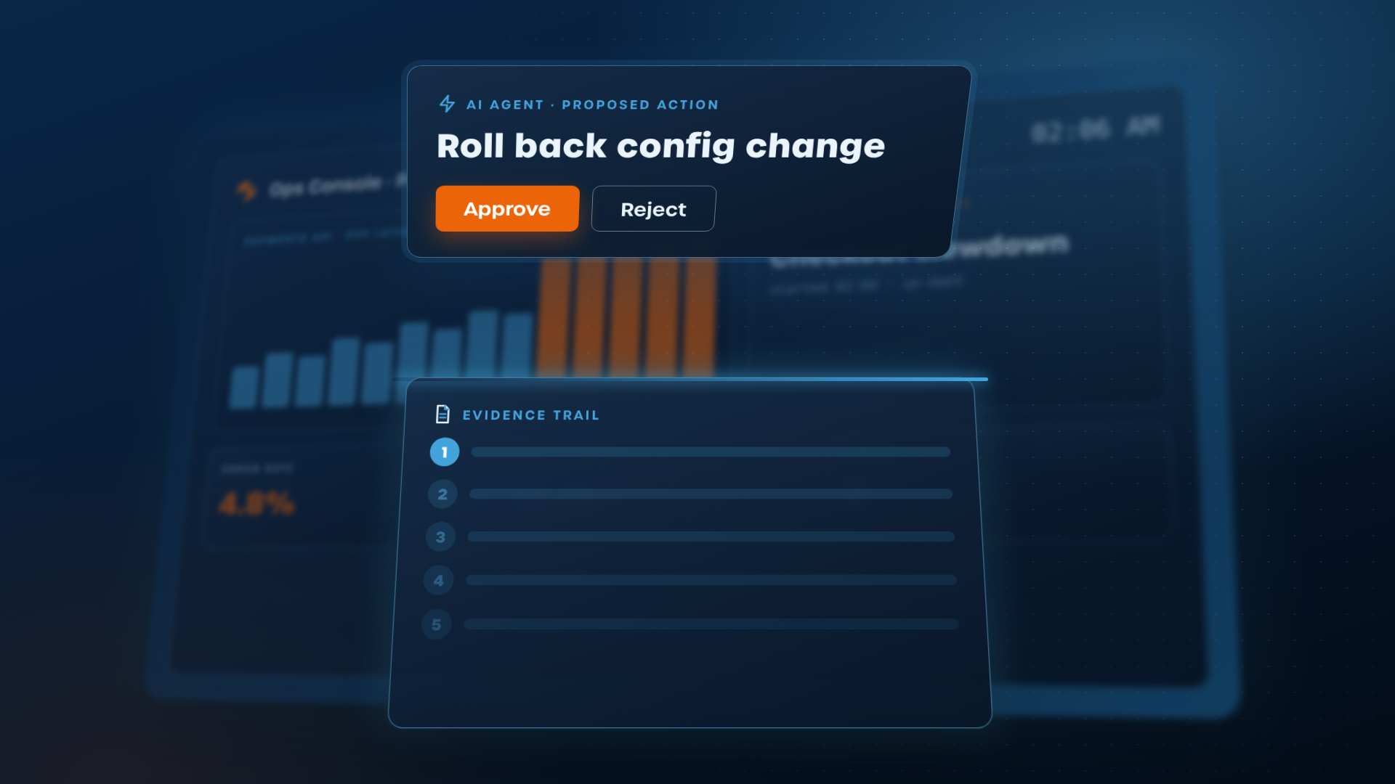
Frame 8
Visual:
The approval box unfolds into an evidence trail panel (animated product UI). Animation: The approval card flips 180° in 3D; its back unfolds downward like an accordion into the evidence trail; the console behind falls away into blur; a scan line sweeps the panel and step 1 starts glowing. [Client demo recording to be placed here, framed in this UI]
Voiceover:
Let's open the trail behind that rollback with this readiness checklist:
Super:
Evidence trail

Slide 9
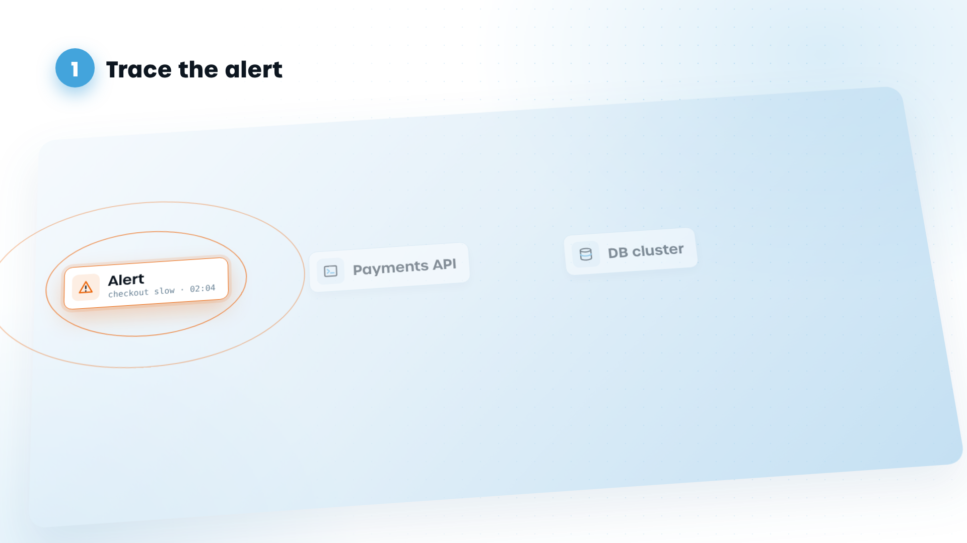
Frame 9
Visual:
The alert node lands on the plane with a shockwave; the other nodes are still faint ghosts waiting to be traced. [Client demo recording to be placed here, framed in this UI]
Voiceover:
(no new VO – same line continues)
Super:
1 · Alert → Payments API → DB cluster

Slide 10
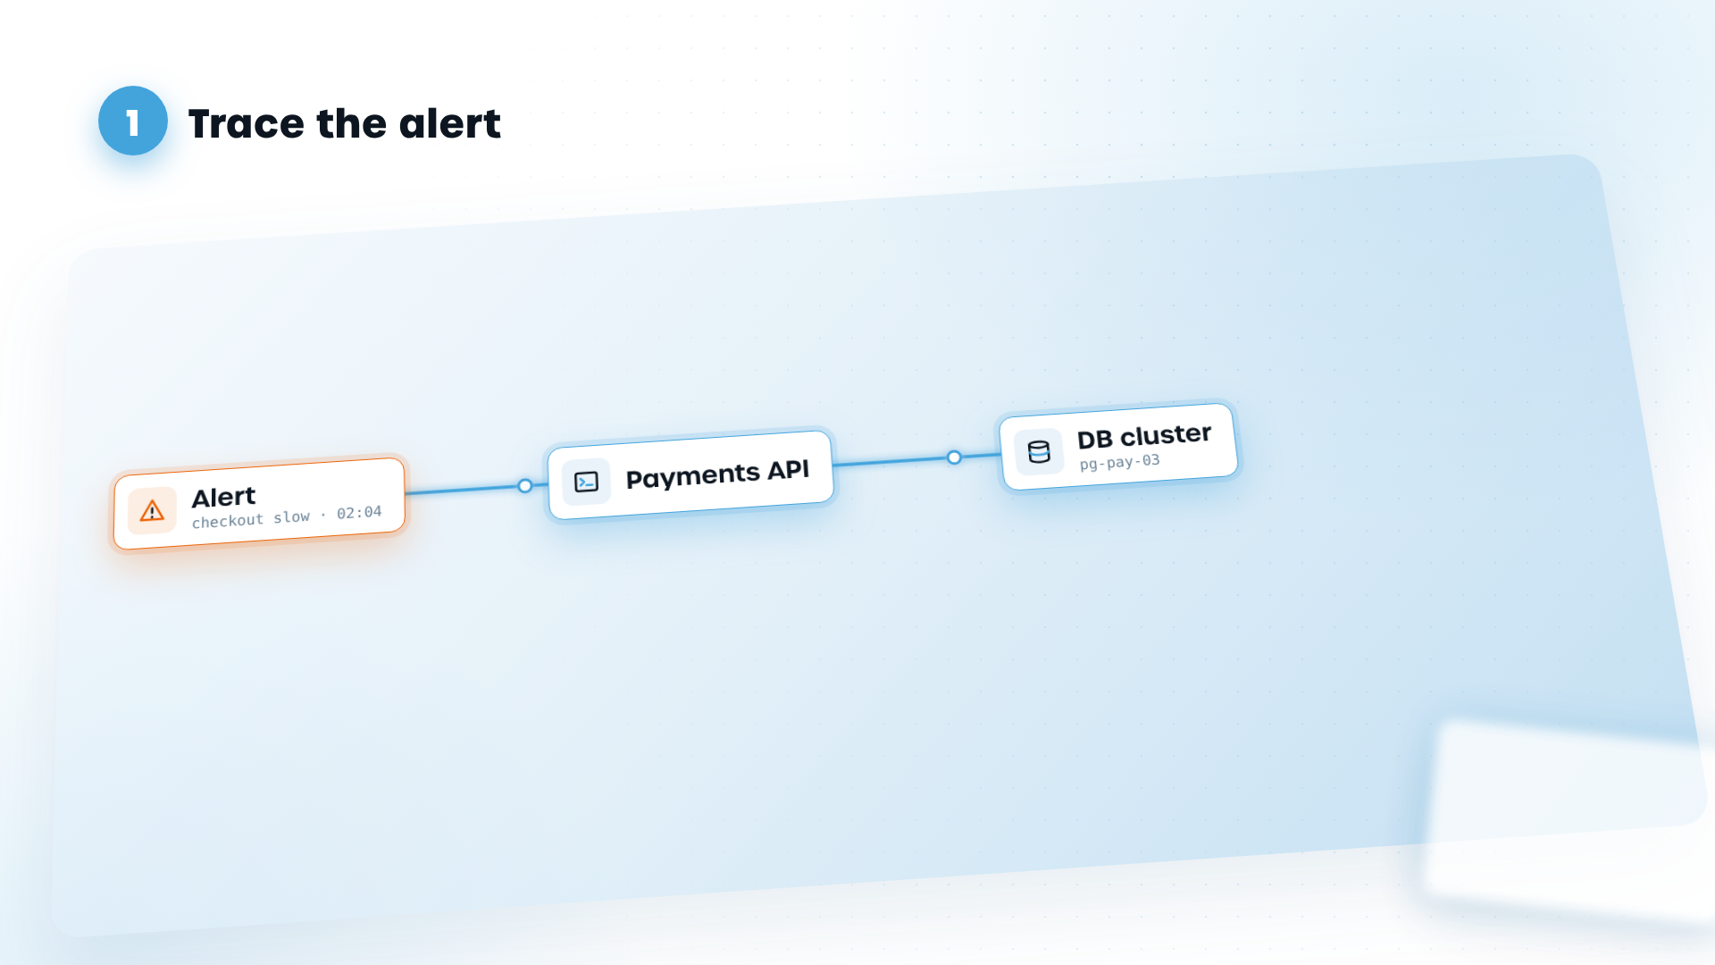
Frame 10
Visual:
Step 1 lights up: Alert → Payments API → Database cluster, on a tilted graph plane. Animation: Camera dolly-tracks left → right along the plane; the alert node pulses orange, a light pulse shoots along the edge to Payments API (whoosh), then on to the DB cluster; each node pops up out of the plane (scale 0.8 → 1 with overshoot). [Client demo recording to be placed here, framed in this UI]
Voiceover:
Step one: The alert traces to the Payments API, which depends on one database cluster.
Super:
1 · Alert → Payments API → DB cluster

Slide 11
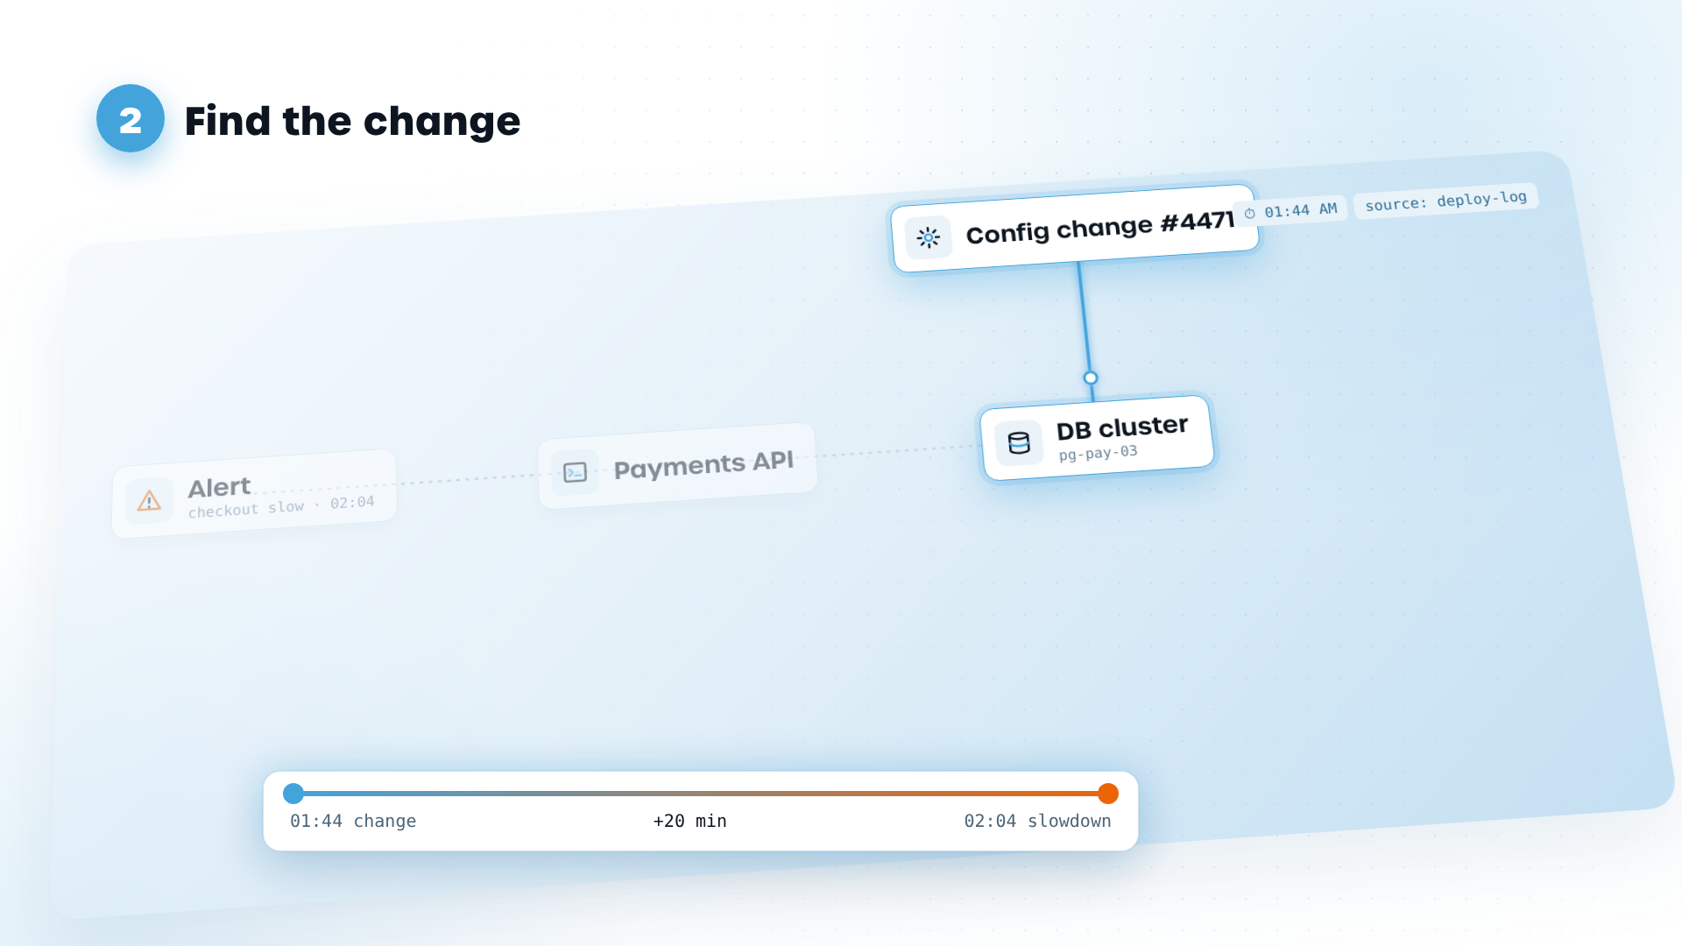
Frame 11
Visual:
Step 2: Config change #4471, applied 1:44 a.m., drops onto the cluster. A timestamp and source tag sit beside it; a timeline shows the 20-minute gap. Animation: Config node slams down from above with a dust-ring ripple; source + timestamp tags flip open like labels; a timeline scrubber races 01:44 → 02:04 under the graph and stamps "+20 min". [Client demo recording to be placed here, framed in this UI]
Voiceover:
Step two: That cluster had a configuration change at 1:44 am, twenty minutes before the slowdown began. Every fact carries its source and its timestamp.
Super:
2 · Config change, 1:44 a.m. · source + time on every fact

Slide 12
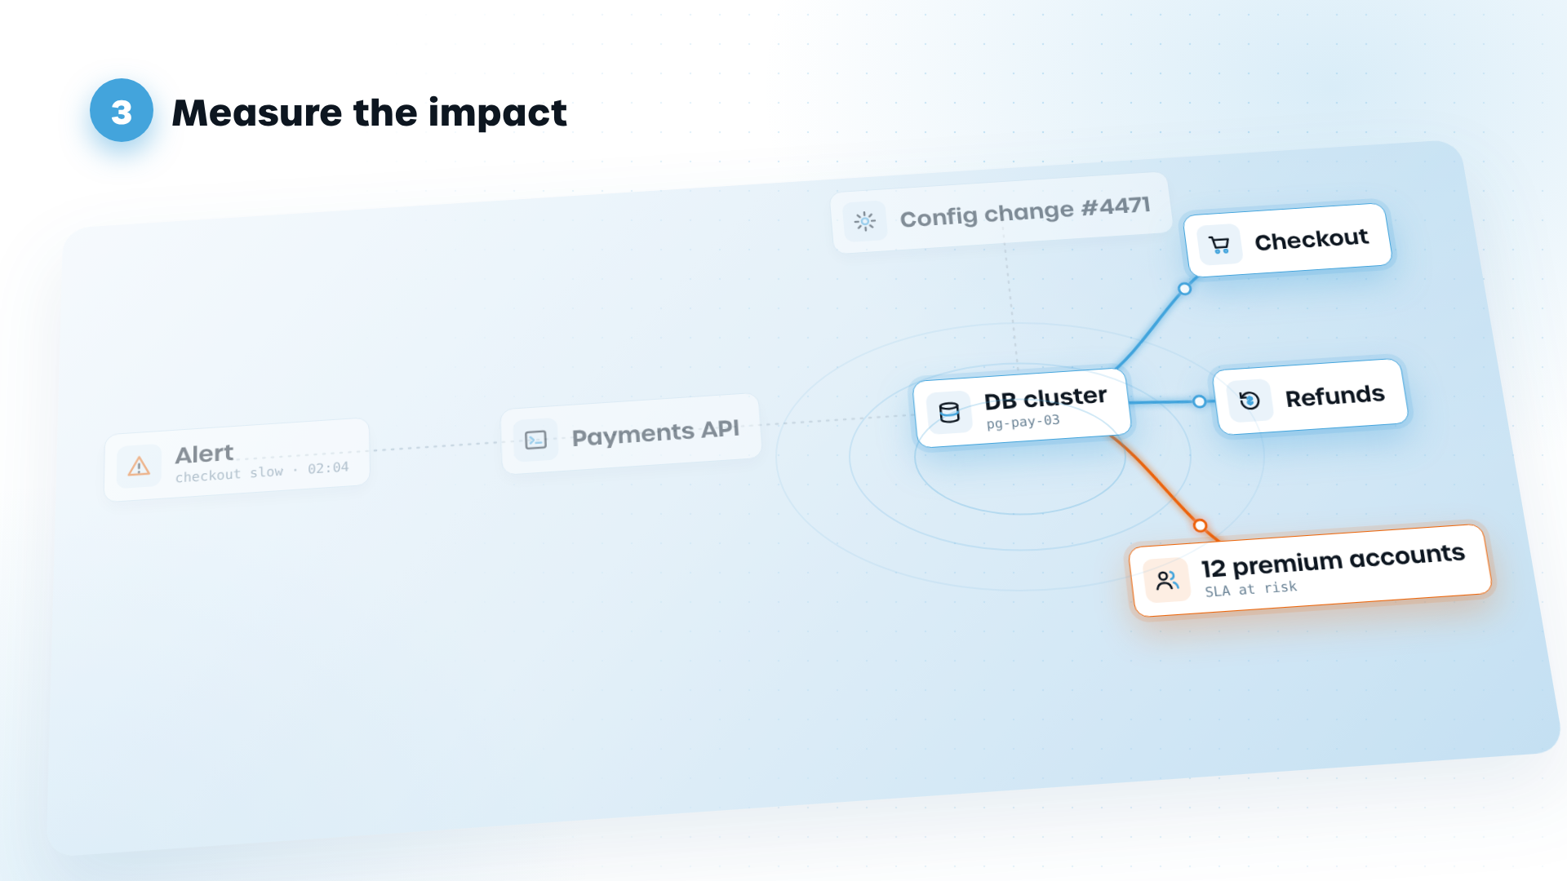
Frame 12
Visual:
Step 3: the path branches out to Checkout, Refunds and 12 premium accounts. Animation: Three branches burst out of the cluster like a shockwave (ring ripples); the camera pulls up to a top-down angle; the '12' counter rolls up on the premium node, which flares orange. [Client demo recording to be placed here, framed in this UI]
Voiceover:
Step three: The same cluster feeds checkout and refunds, and twelve premium customers are affected. Now that's an impact, not a guess.
Super:
3 · Checkout, Refunds · 12 premium accounts

Slide 13
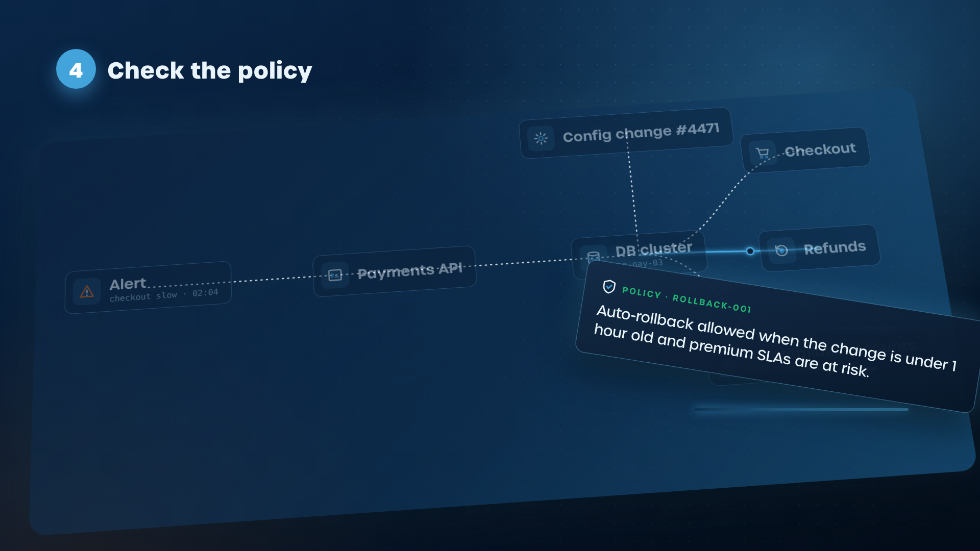
Frame 13
Visual:
The policy card whips in from screen right with motion streaks and a slight spin, about to dock onto the path. [Client demo recording to be placed here, framed in this UI]
Voiceover:
Step four: Before acting, this agent checked your rollback policy, which lives in the graph alongside the data. The change is under an hour old.
Super:
4 · Policy checked ✓

Slide 14
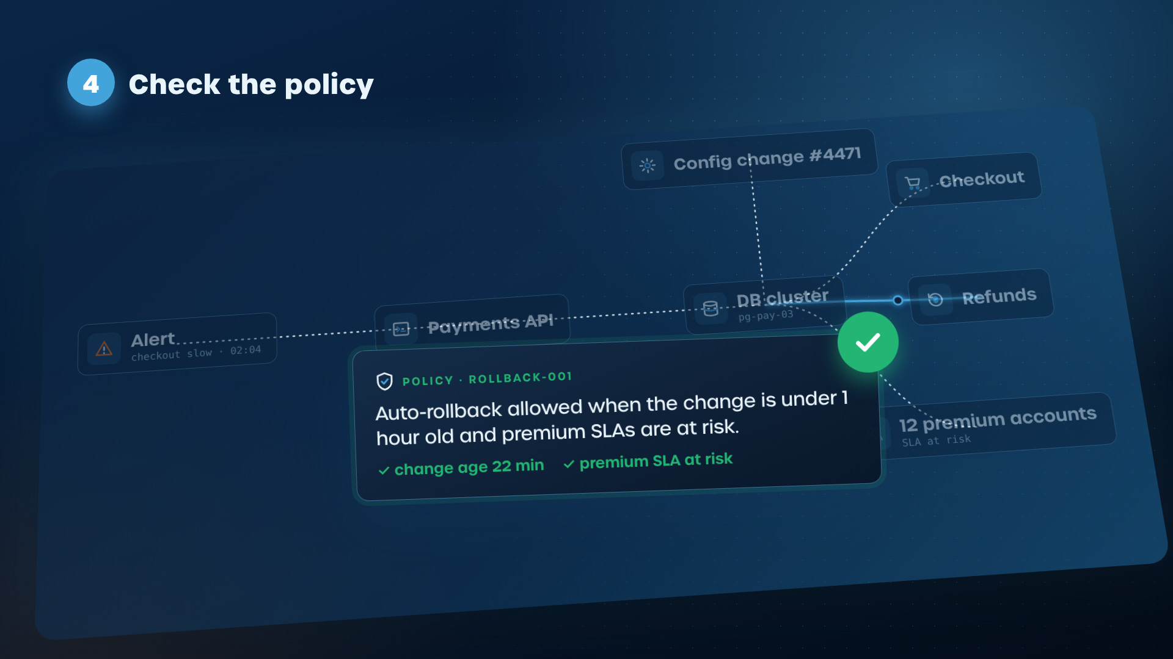
Frame 14
Visual:
Step 4: a policy card plugs into the path: "Auto-rollback allowed when the change is under 1 hour old and premium SLAs are at risk." A green tick. Animation: The policy card spins in from screen right and docks onto the graph like a puzzle piece; the two conditions tick one by one on the VO; a big green tick stamps with a satisfying click and a soft glow wave washes over the path. [Client demo recording to be placed here, framed in this UI]
Voiceover:
Premium customers are at risk. The rule allows it.
Super:
4 · Policy checked ✓

Slide 15
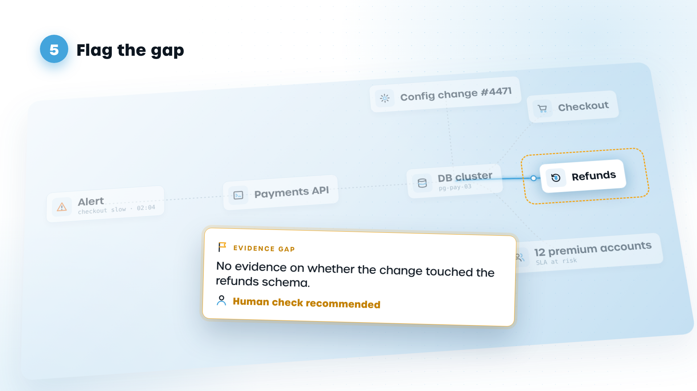
Frame 15
Visual:
Step 5: an amber flag on Refunds: "No evidence on whether the change touched the refunds schema. Human check recommended." Animation: The Refunds node glitches/flickers; a dashed amber ring scans around it; the flag card unfolds from the node; a human avatar slides in and the handoff arrow draws from agent to human. [Client demo recording to be placed here, framed in this UI]
Voiceover:
And step five: the agent says what it doesn't know. It found no evidence on the refunds data, so it asked a human to check.
Super:
5 · Gap flagged → human check

Slide 16
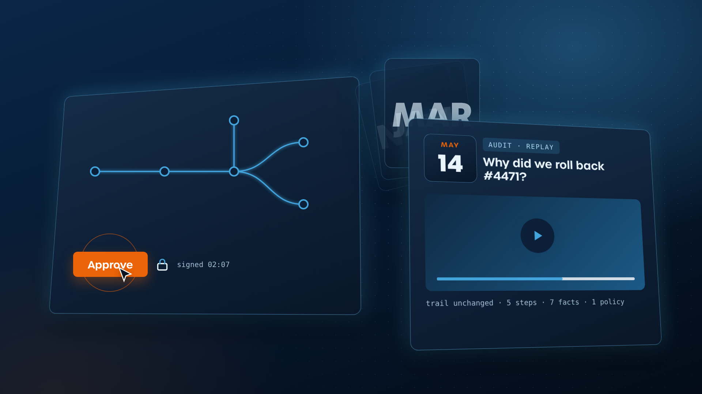
Frame 16
Visual:
The full trail on one card; cursor clicks Approve and it locks as "signed". Then a calendar flips forward six months and an auditor replays the same trail, unchanged. Animation: Click: ripple burst + confirm chime, a lock icon snaps shut on the trail. Whip-pan right as calendar pages tear off in a flurry (NOV → MAY); the auditor's window swings in from depth and a play scrubber replays the trail, nodes re-lighting in order.
Voiceover:
Now you're not trusting a score.
Super:
Approve with evidence · Replay it later

Slide 17
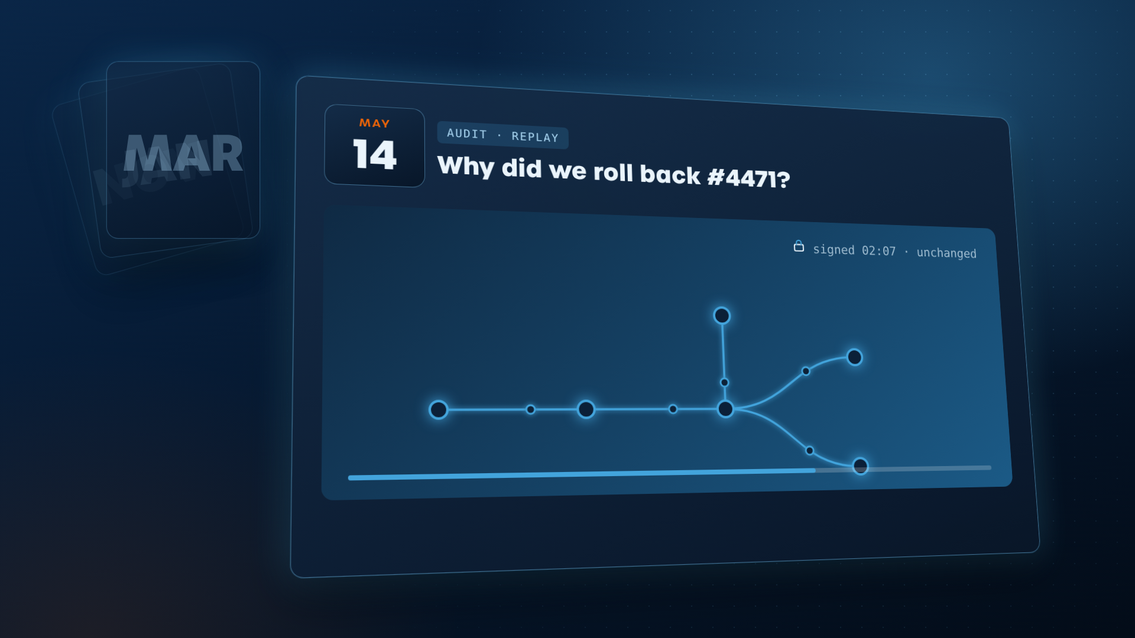
Frame 17
Visual:
After the calendar flurry, the auditor's window fills the frame: the same trail replays node by node, unchanged, with the original sign-off stamp.
Voiceover:
You're approving a decision you can read. And six months from now, when someone asks why, the same trail is still there to replay.
Super:
Approve with evidence · Replay it later

Slide 18
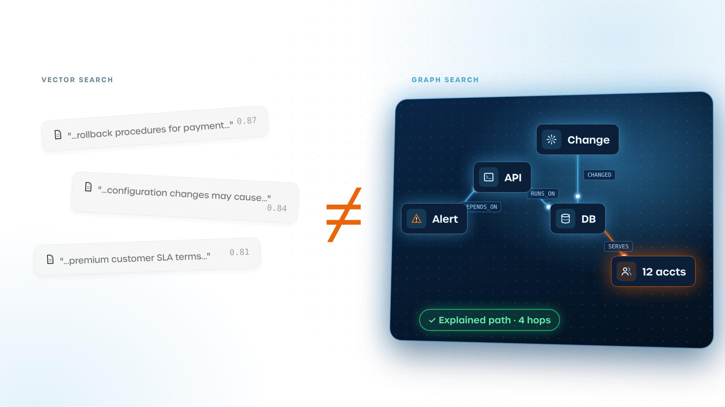
Frame 18
Visual:
Split: vector search is plain and flat (three grey text chunks with similarity scores). Graph search is the hero: a glowing deep-navy panel where the connected path lights up, every link labelled, ending in an "Explained path" badge. Animation: Left: chunks drop in, scores count up, then drift apart with no links (floaty, unanchored). Right: the demo path draws itself in one continuous stroke and settles firmly. A big '≠' slams in between with a bass hit.
Voiceover:
You might ask, "why does this need a graph?" Because vector search can only tell you which passages looked similar to the question. It can't tell you why they matter to the decision.
Super:
Similar ≠ explained

Slide 19
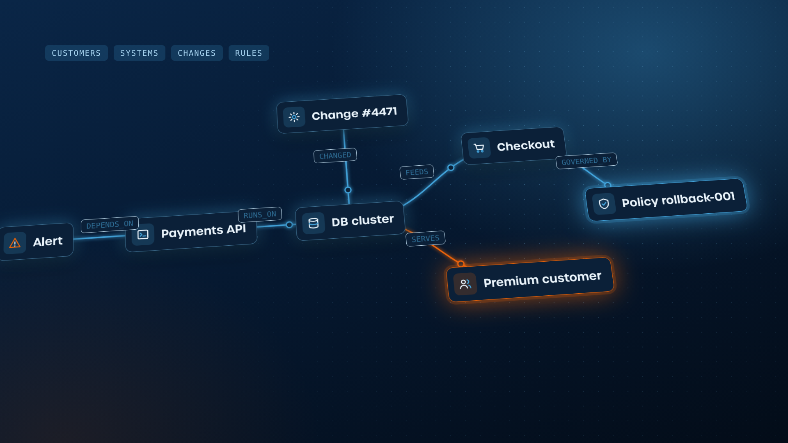
Frame 19
Visual:
The path from the demo, now with every connection labelled (customers, systems, changes, rules). Animation: Low-angle camera glides along the tilted path like a fly-through; each relationship label flips up as the light pulse passes it; legend chips pop in at the end and the whole graph settles into a hero composition.
Voiceover:
In a graph search, the customers, systems, changes and rules are connected explicitly. So the path the agent followed is pretty clear. Nothing has to be reconstructed after the fact.
Super:
The path is the explanation

Slide 20
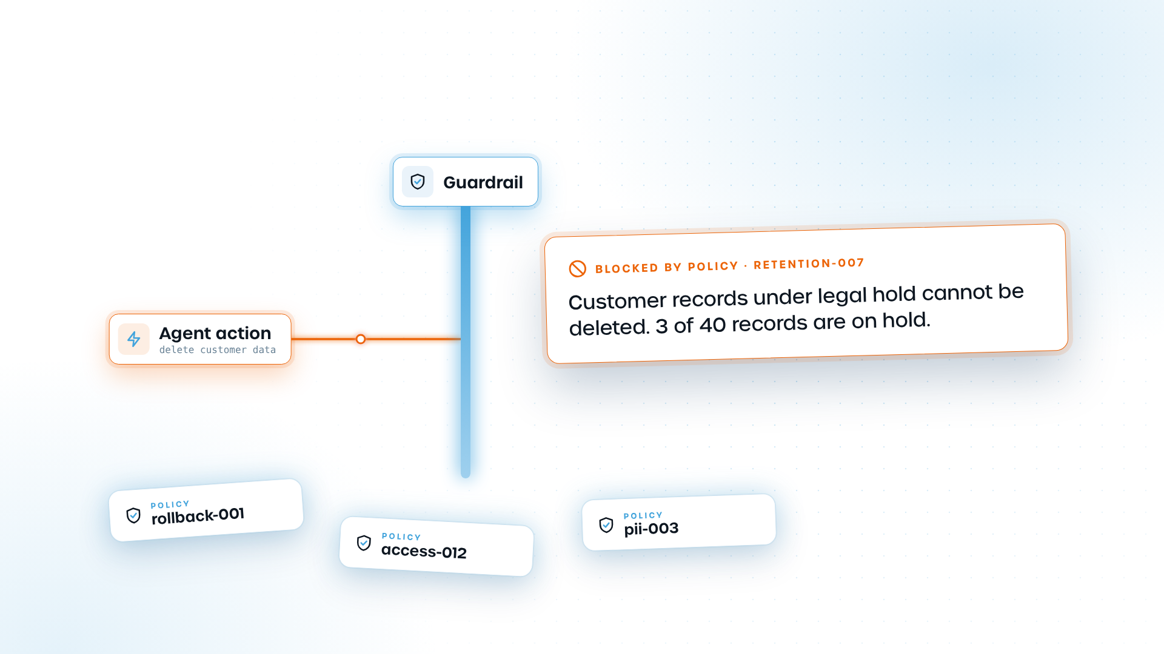
Frame 20
Visual:
Policy cards slot into the graph as guardrails; one blocks an agent action and shows the reason. Animation: Policy cards fly in and lock onto the graph rails with a magnetic snap; the agent's action arrow races toward the guardrail, hits it and bounces back with a shake; the 'Blocked' card expands and the reason types on.
Voiceover:
Your policies sit in the graph too, as guardrails. So when an agent refuses to act, it can explain that as well.
Super:
Guardrails with reasons

Slide 21
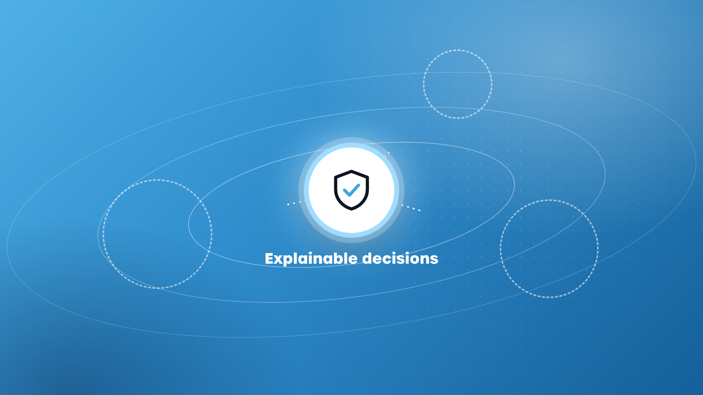
Frame 21
Visual:
The shield hub drops in and pulses; dashed orbit slots show where the three sectors will swing in; edges start firing outward.
Voiceover:
(no new VO – same line continues)
Super:
Explainability: from best practice to requirement

Slide 22
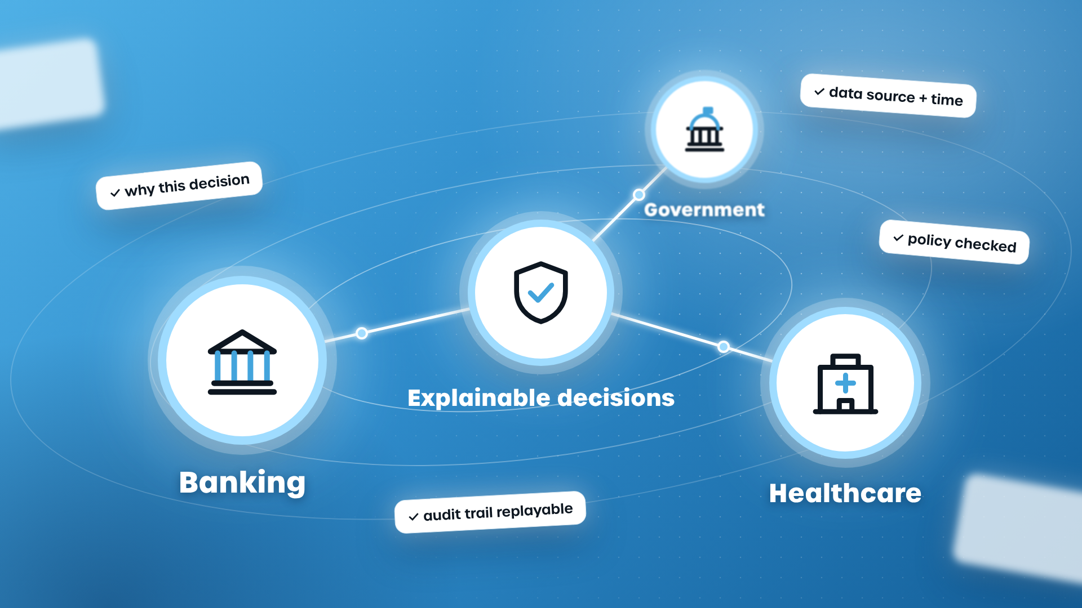
Frame 22
Visual:
Hub-and-orbit composition on TG Blue: an 'Explainable decisions' shield hub at the centre, with Banking, Healthcare and Government as glowing circle nodes (brand line icons) orbiting at different depths, linked by orange edges. Small proof chips float around them. No regulation named. Animation: Shield hub drops in and pulses; orbit rings spin up; the three sector nodes swing in along the orbit (big Banking passes close to camera, Government sits far back, out of focus); edges fire outward from the hub; proof chips pop on with a stagger; camera arcs 15° around the hub throughout so nothing is static.
Voiceover:
And in regulated industries, explaining automated decisions is becoming a requirement, not a nice-to-have.
Super:
Explainability: from best practice to requirement

Slide 23
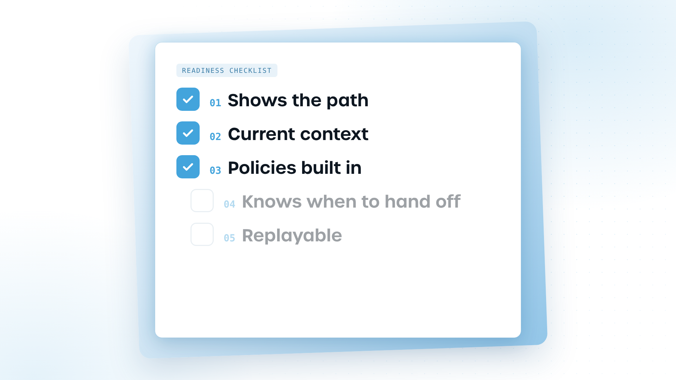
Frame 23
Visual:
A five-item readiness checklist builds one line at a time. Animation: The card swings in from a 3D angle and flattens; each line slides in from the right with a stagger, its tick-box drawing itself and filling TG Blue as it's named; the camera slowly pushes in.
Voiceover:
So before you trust an agent with multi-step decisions, run this checklist.
Super:
Readiness checklist

Slide 24
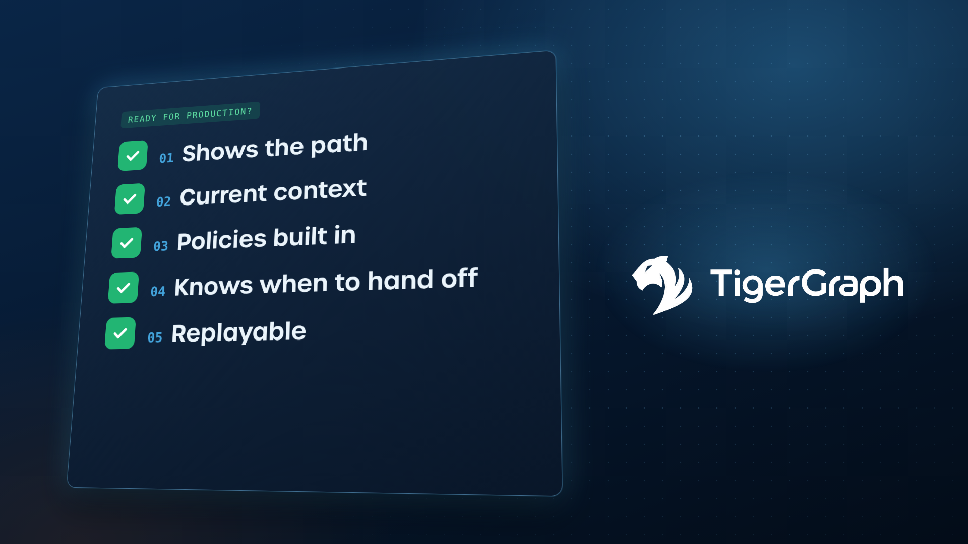
Frame 24
Visual:
All five ticks turn green next to the TigerGraph logo. Animation: Ticks flip to green in a fast domino cascade with rising pitch SFX; the card slides left and tilts away; the TigerGraph logo builds on the right (tiger head draws on, wordmark wipes in) with a soft blue bloom.
Voiceover:
If you can't tick all five, the agent isn't ready for production.
Super:
Ready for production?

Slide 25

Frame 25
Visual:
The checklist slides away; the TigerGraph logo resolves in the centre with a green 'ready' tick badge and a blue bloom.
Voiceover:
But TigerGraph is built to tick them all.
Super:
Ready for production?

Slide 26

Frame 26
Visual:
End card on TG Blue: white logo, tagline, CTAs "Request a demo" and "Start free", tigergraph.com. Animation: Network texture drifts slowly behind; logo holds centre; tagline fades up word by word; CTA buttons rise with a soft bounce. Hold clean for the last 4-5 s.
Voiceover:
Regular models predict. TigerGraph proves.
Super:
Regular models predict. TigerGraph proves.

